Slide 1

City of Chicago, Analysis of the West Nile Virus
EDWIN, LING CHONG GOLD, LOW GUAT HWA, SAPNA

Slide 2
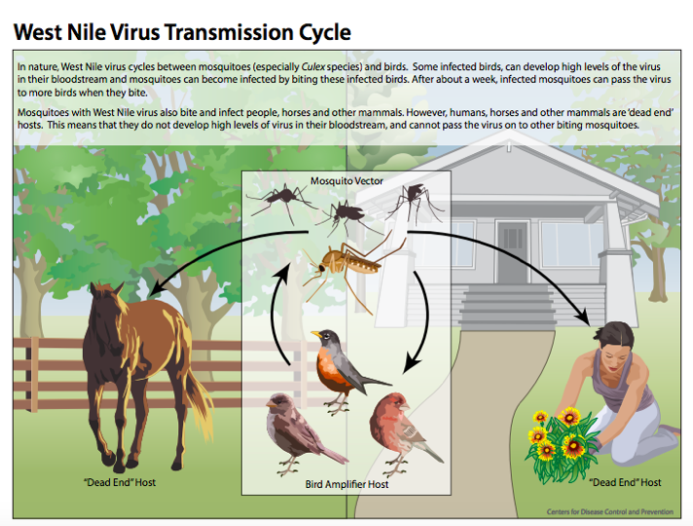

Slide 3
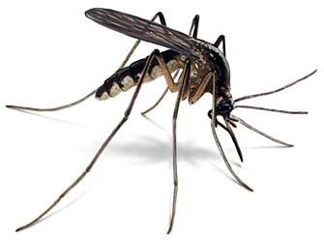
About West Nile Virus:
It is an infectious disease.
It is most commonly spread to people by the bite of an infected mosquito.
Cases of WNV occur during mosquito season , which starts in the summer and continues through fall.
WNV has the potential to cause prolonged disability or death in people who are infected.
There are no vaccines to prevent or medications to treat WNV in people. Since 1999, nearly 2,000 US residents have died from WNV complications
The most effective way to prevent infection from ­­­West Nile virus is to prevent mosquito bites.
The surveillance allows local government to take action (mainly in the form of mosquito spraying ) to prevent the spread of WNV.

Slide 4
The main goal of our analytics is to create a model that can help to identify locations with high mosquito population so that pesticides can be sprayed in time to eliminate them.
This Photo by Unknown Author is licensed under CC BY

Slide 5
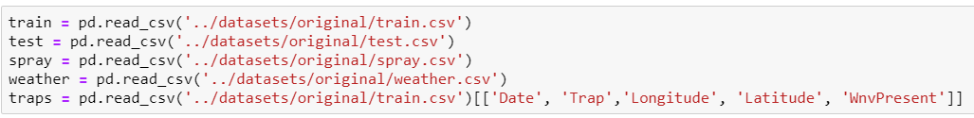
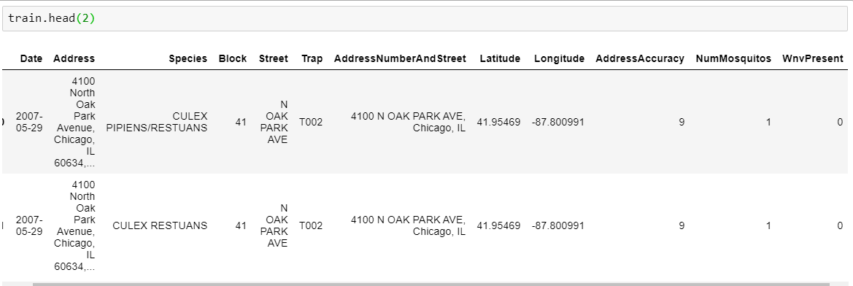
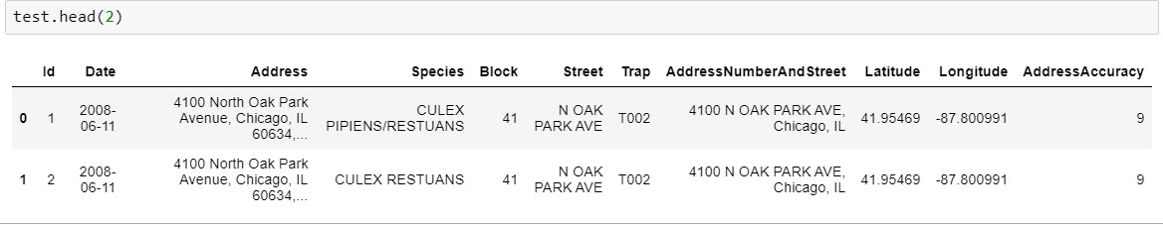
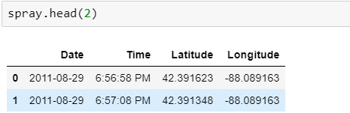
Load Data
Train Dataframe
(2007/09/11/13)
Test Dataframe
(2008/10/12/14)
Spray Dataframe
(2011/13)

Slide 6
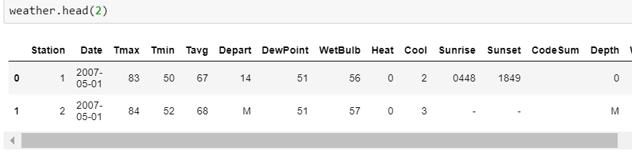
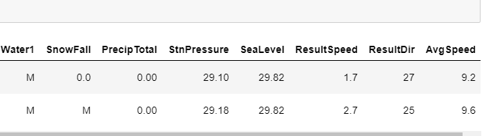
Weather Dataframe
(2007 - 2014)

Slide 7
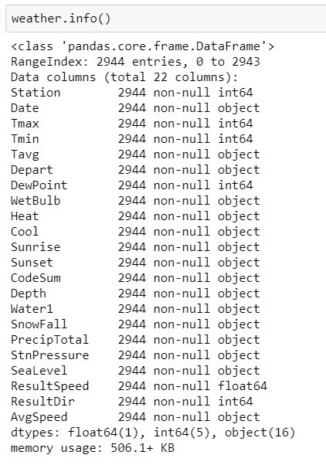
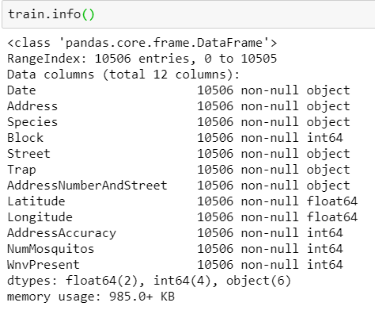
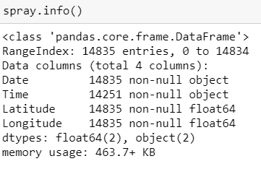
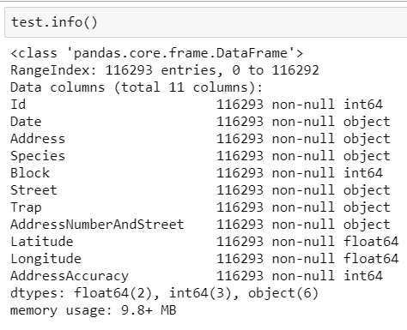
Train Data
Test Data
Spray Data
Weather Data

Slide 8
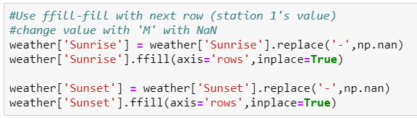
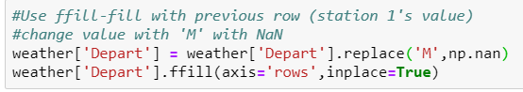
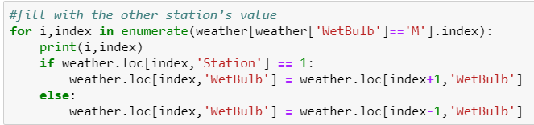
Cleaning
Sunrise and Sunset: The time is same for the whole Chicago
Weather Data
Replace missing value by Station 1’s value
1. Depart Temp
2. Wet Bulb Temp
3. Sunrise & Sunset
4. Average Speed
Depart temp: It is difference in temp for the day against for the past 30 years
Average Speed: We have 3 missing data in AvgSpeed. Going through the data, the difference between the 2 station's AvgSpeed minimal, at a range of 0 to 2. As such we will fill the
missing Average speed with the average speed of the corresponding station for the same day.
Wet Bulb temp: Lowest temp that can be reached by evaporating water into air.

Slide 9
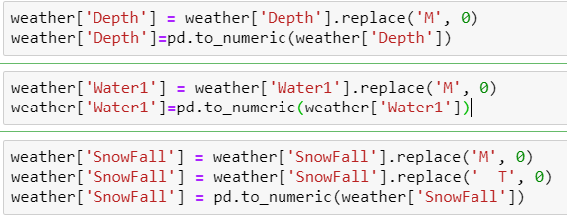
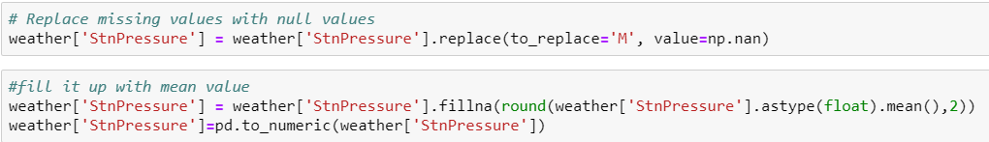
Cleaning
As our data is collected from the period of time when Chicago do not experience any snowfall, we will fill up the missing data with 0 and convert them to numeric
Weather Data
No Snowfall
1. Depth
2. Water1
3. Snowfall
No Outliers and so replaced with its mean value
Mean
1. Station Pressure
2. Sea Level

Slide 10
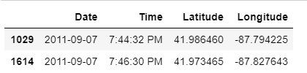
Cleaning :
Code Sum
Code Sum indicates the weather phenomena for the day. Indicated in Kaggle's data description, if CodeSum is blank, it means there are no signs of any special weather phenomena. We will replace the blanks with 'No Sign'
Code Sum
Code Sum
We have 584 null values in time.
Spray Data
The entry before and after our null values are also of the same date. The time before the start of our null values is 7:44:32 PM and the time after our null values is 7:46:30 PM. Looking at other rows of data, we can see that time for the same date are in running order when going down the rows, as such we will fill the null values with 7:45:00 PM. Then convert the time to 24 hour format.

Slide 11
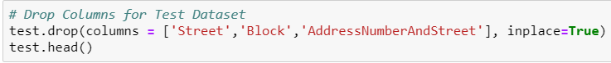
Cleaning
Train DataSet has no null values so nothing needs to be done for this step.
There is a total of 10506 observations and 12 columns.
Train Data
Dropping Street, Block, Address Number and Street Columns
Drop
1. Street
2. Block
3. AddressNumber&Street
Test DataSet has no null values There is a total of 116293 observations and 11 columns. Test Dataset does not contain NumMosquitos and WnvPresent columns.
But has an additional Id column.
Test Data
Drop
1. Street
2. Block
3. AddressNumber&Street
Dropping Street, Block, Address Number and Street Columns

Slide 12
EDA

Slide 13

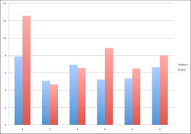
EDA: WnvPresent Against Features
Trends
Relationships

Slide 14
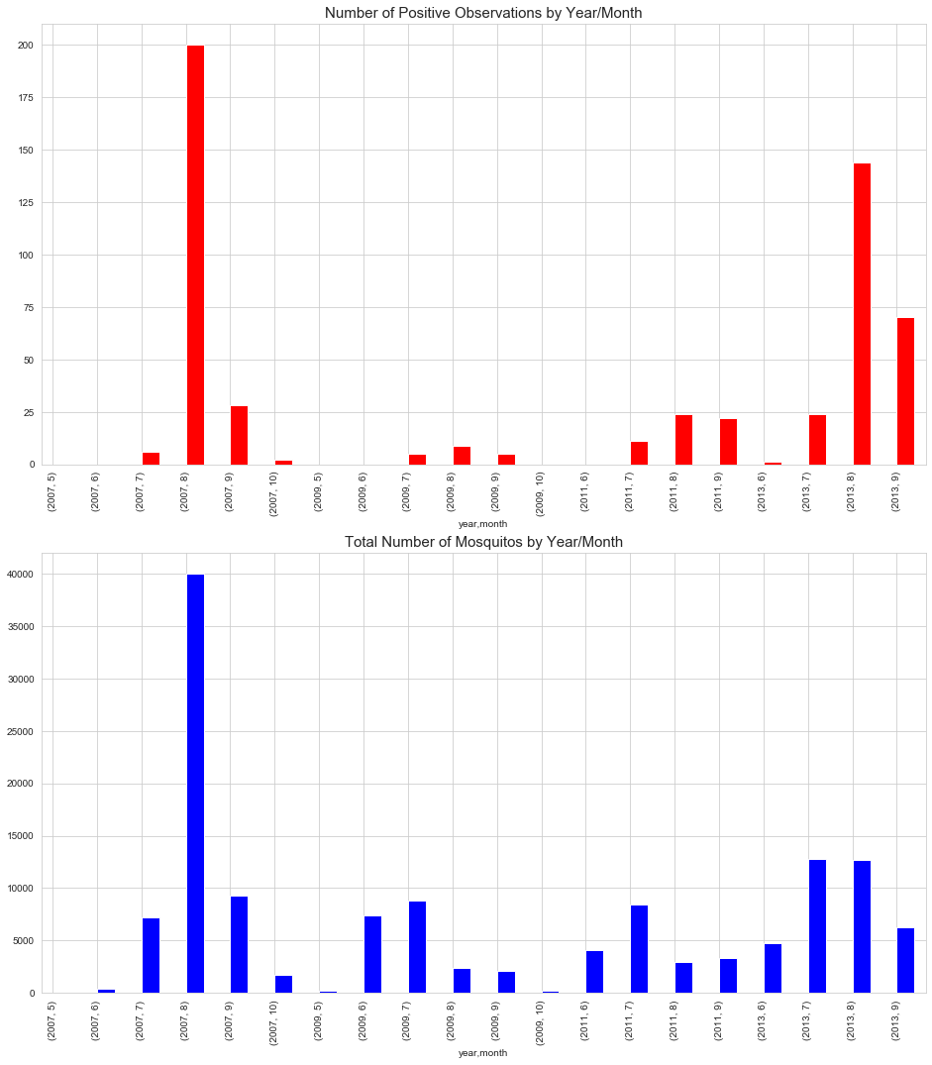
EDA: Trends
Red = WnvPresent
Blue = Number of Mosquitoes
We will be using the observations plot throughout this section

Slide 15
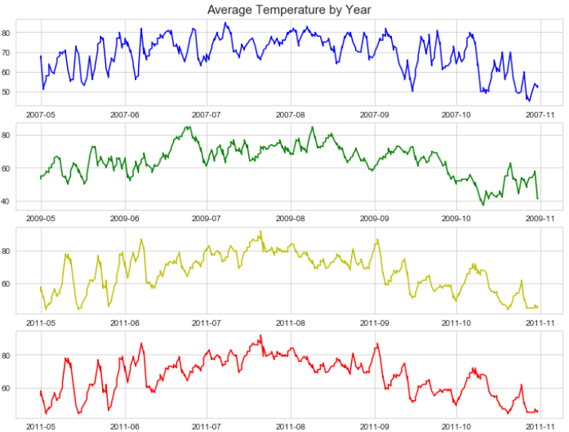
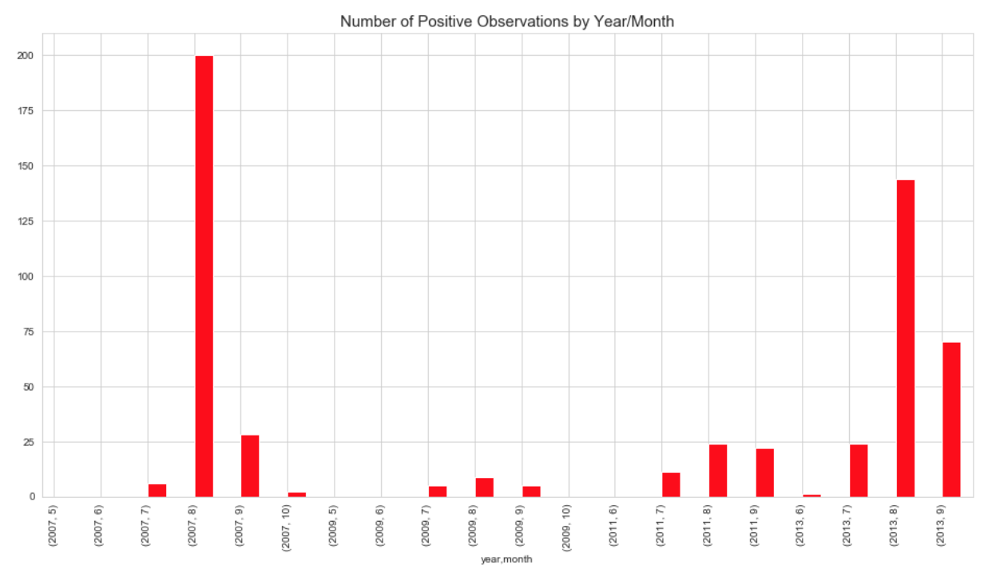
EDA: Trends

Slide 16
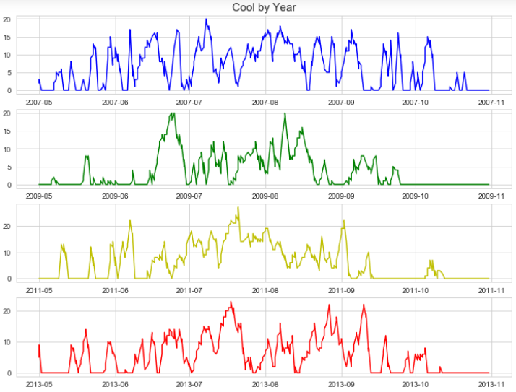
EDA: Trends

Slide 17
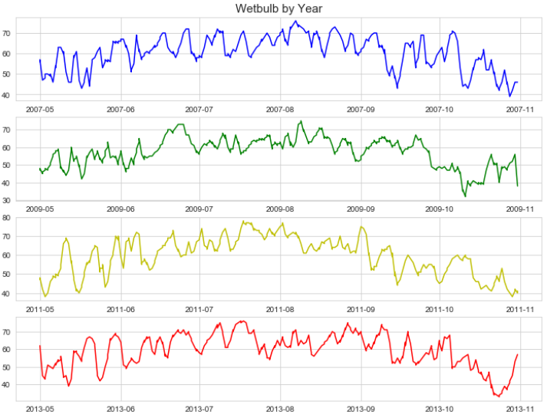
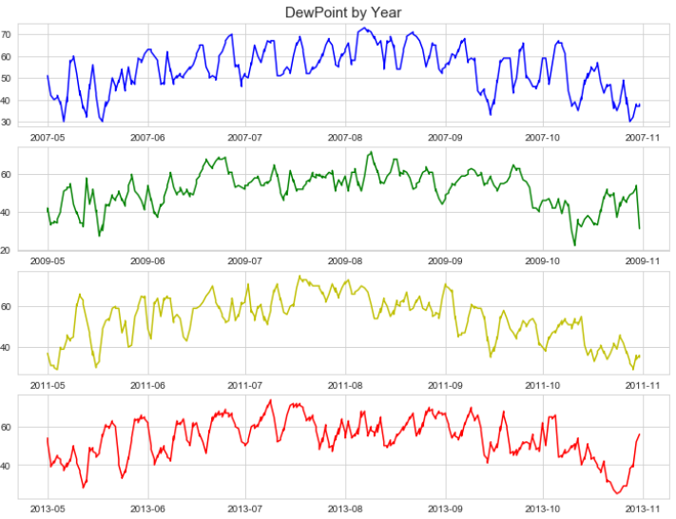
EDA: Trends

Slide 18
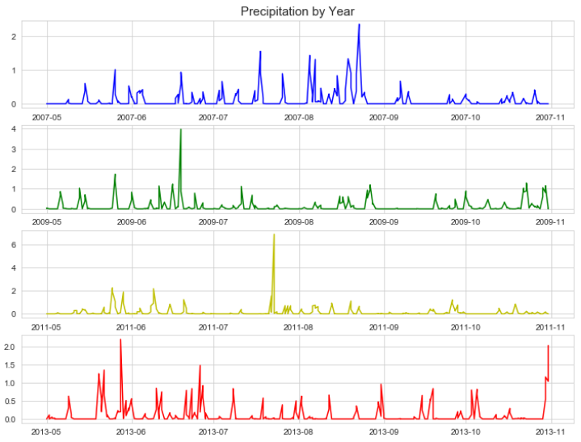
EDA: Trends

Slide 19
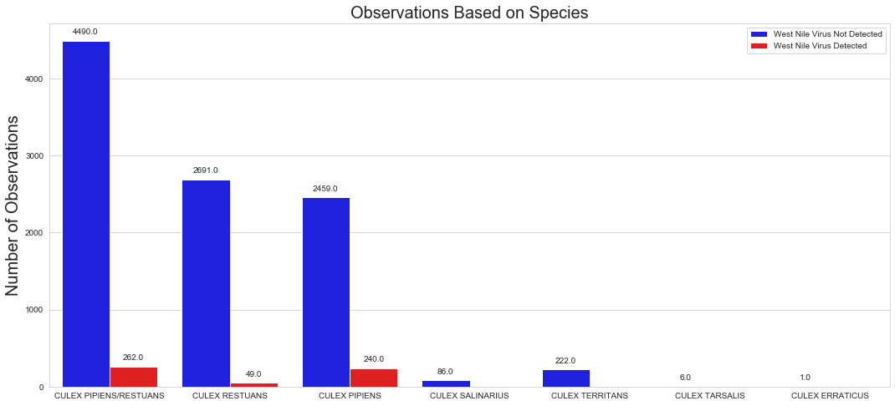
EDA: Relationship

Slide 20
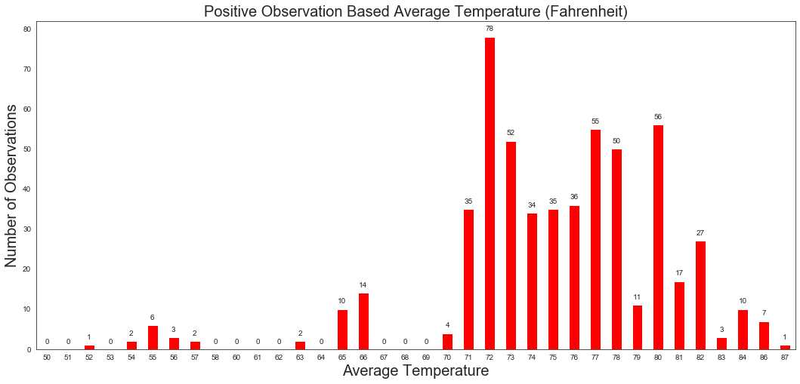
EDA: Relationship

Slide 21
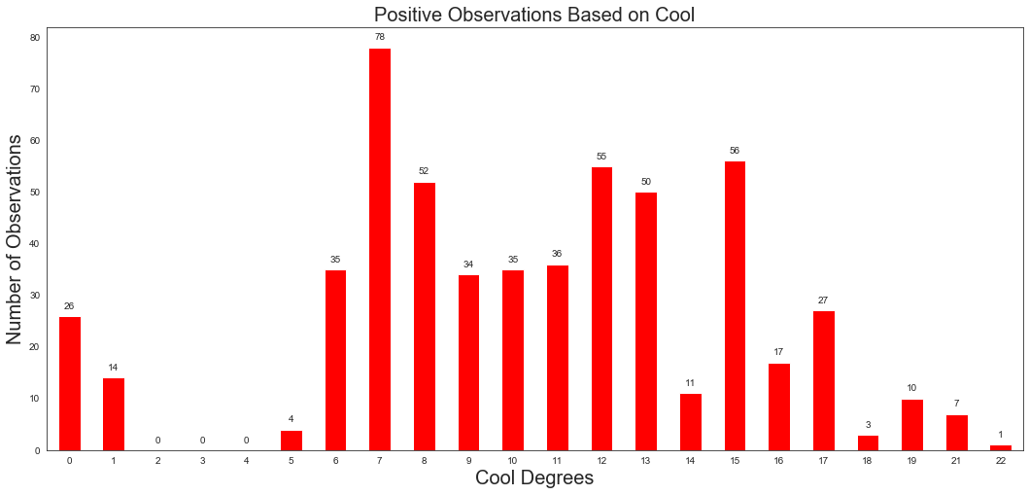
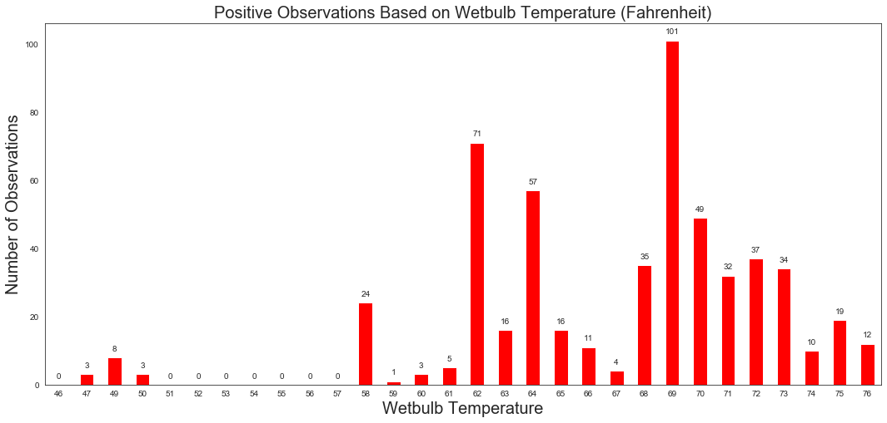
EDA: Relationship

Slide 22
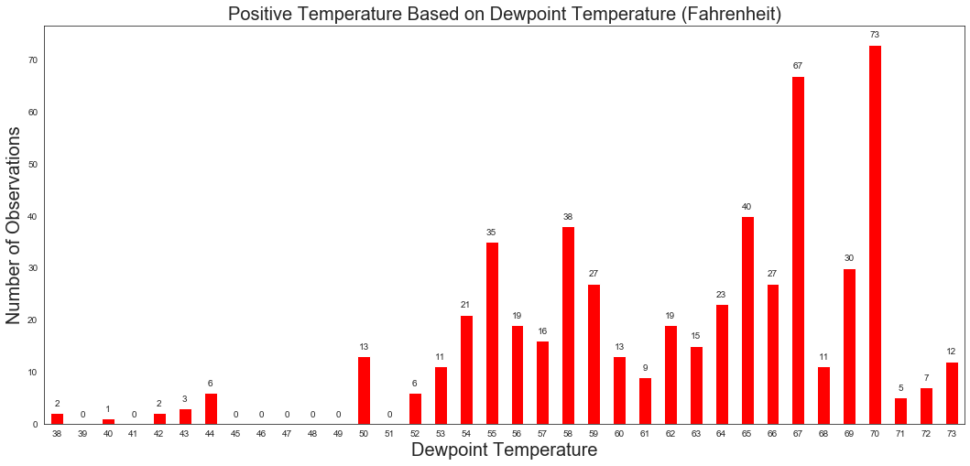
EDA: Relationship

Slide 23
EDA: Relationship

Slide 24
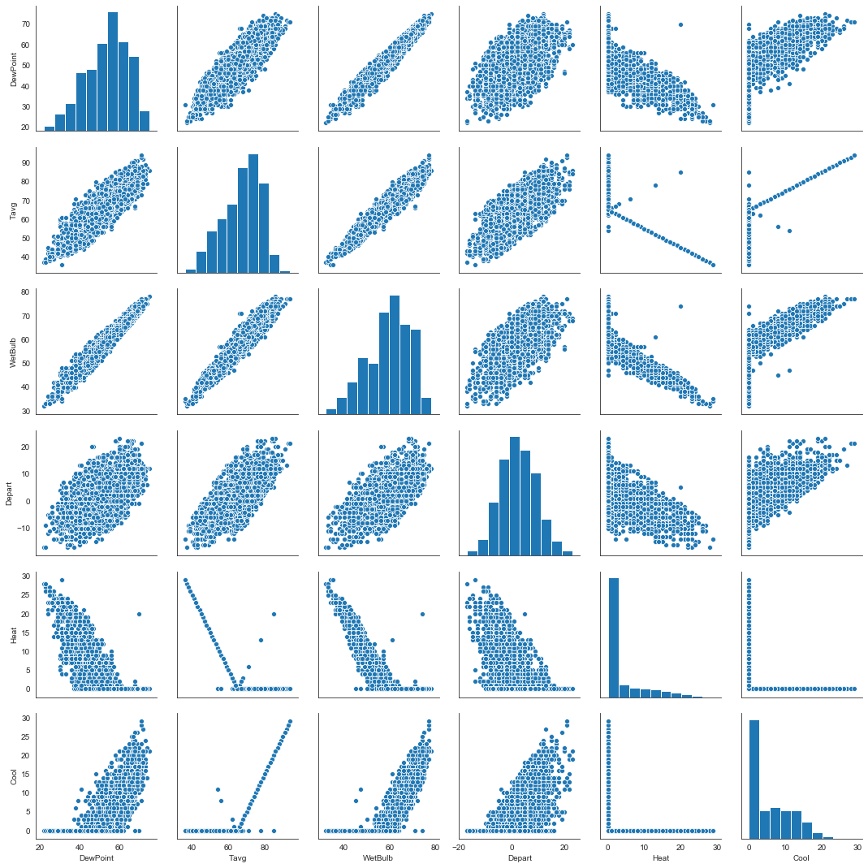
EDA: Relationship
WetBulb & DewPoint
Both are measurements about humidity
Tavg & WetBulb
Increase in temperature, increase in humidity

Slide 25
Trap Analysis /
Feature Engineering

Slide 26
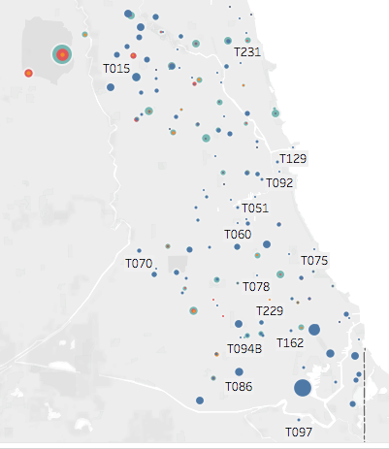
Trap Locations
(where are the hotspots?)

Slide 27
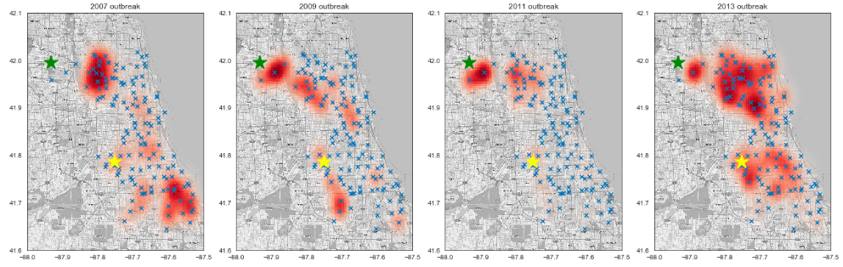
Heatmap of outbreak(2007,2009,2011,2013)
station 1
station 2

Slide 28
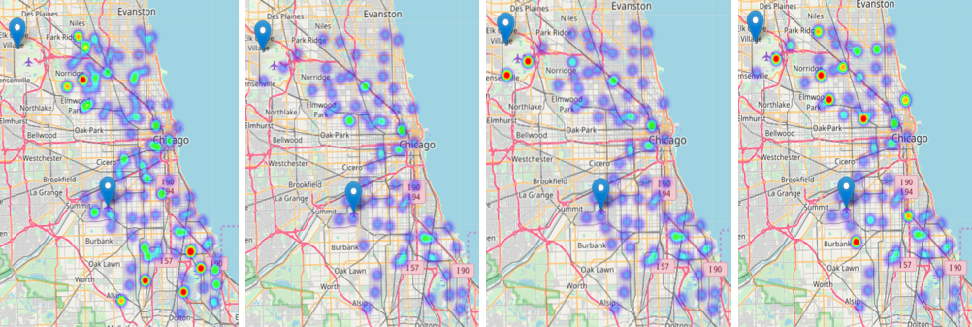
Heatmap of outbreak(2007,2009,2011,2013)

Slide 29
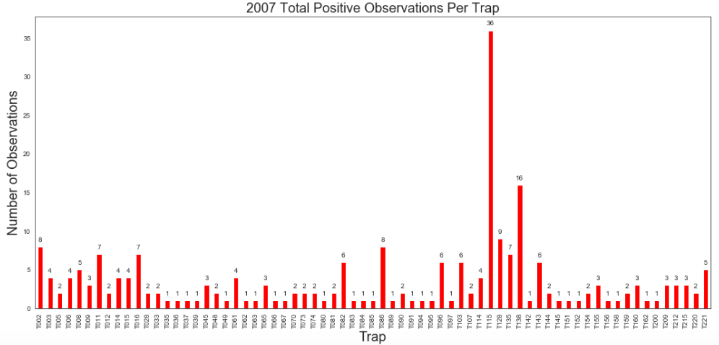
Trap Infection Count (2007)
Top Trap
T115

Slide 30
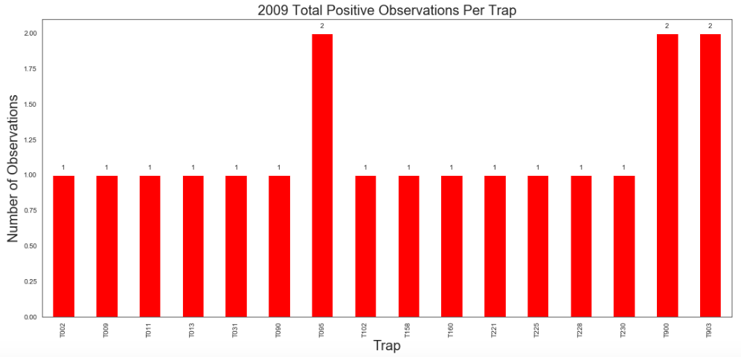
Trap Infection Count (2009)

Slide 31
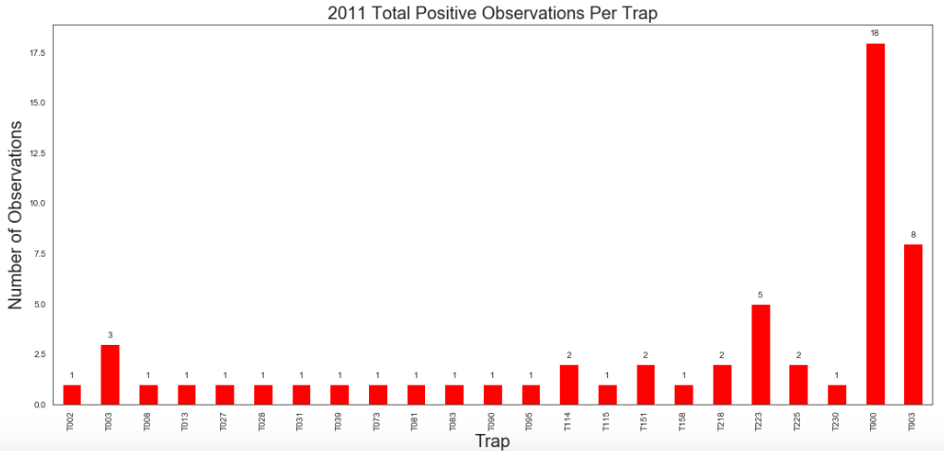
Trap Infection Count (2011)
Top Trap
T900

Slide 32
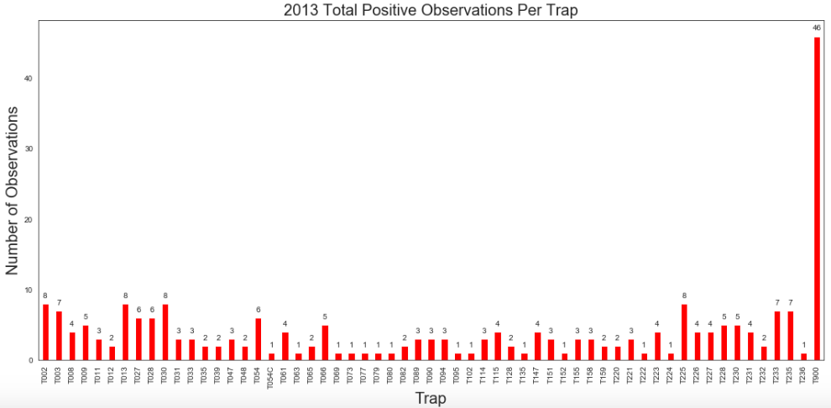
Trap Infection Count (2013)
Investigate
T900 !

Slide 33
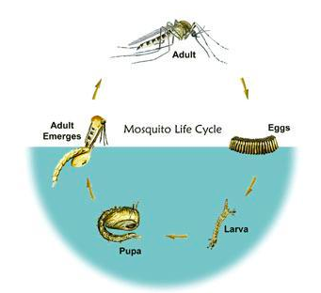
Investigate Trap T900
Where does the mosquitos come from ?
Life Cycle of Mosquitos
Lay eggs near water
eggs -> Larva -> Pupa, in water (2-3 days)
full cycle to adult ~ 5-8 days
Investigate weather columns link to humidity!
Investigate temperature!

Slide 34
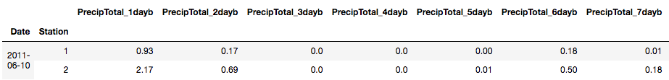
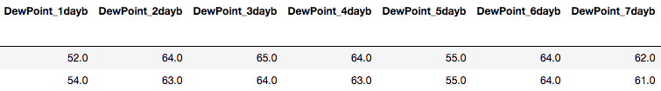
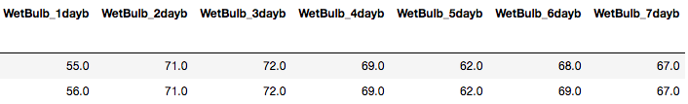
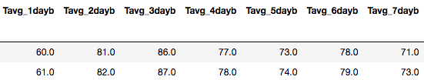
Trap T900 (prior 7 days weather readings)
2011-06-09 2011-06-08 2011-06-07 2011-06-06 2011-06-05 2011-06-04 2011-06-03
Columns
PrecipTotal
WetBulb
DewPoint
Tavg
4 x 7 = 28 new features created

Slide 35
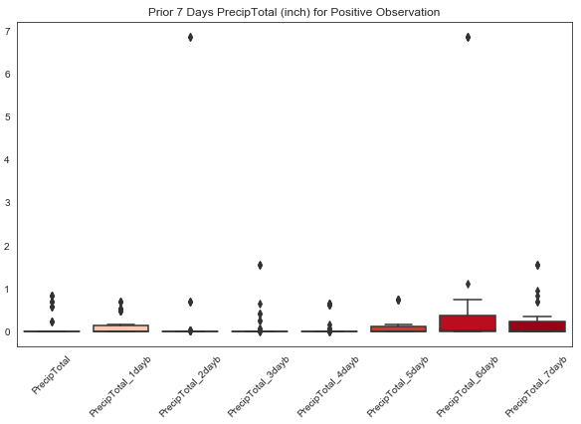
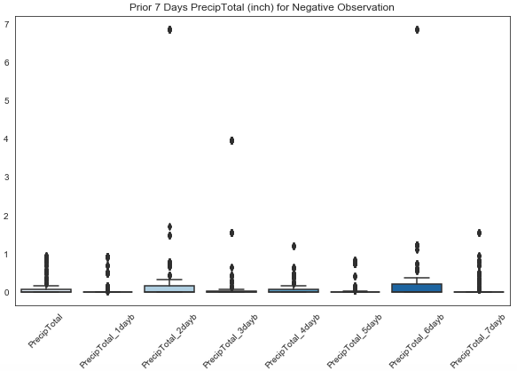
Trap T900 (PrecipTotal Column)
with WnV
without WnV

Slide 36
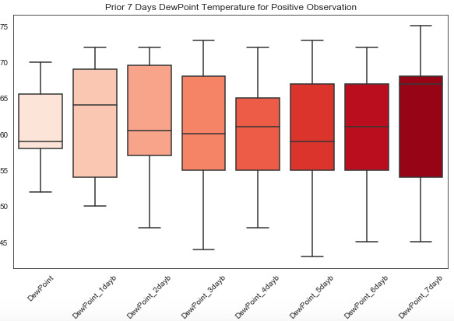
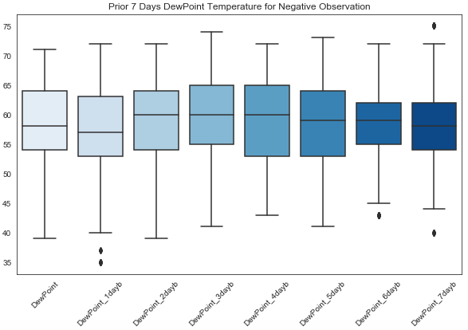
Trap T900 (DewPoint Column)
with WnV
without WnV

Slide 37
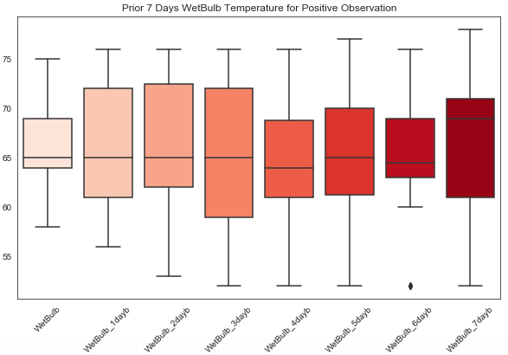

Trap T900 (WetBulb Column)
with WnV
without WnV

Slide 38


Trap T900 (Tavg Column)
with WnV
without WnV

Slide 39
Include all 28 new features for modeling

Slide 40
Modeling /
Conclusion

Slide 41

Modelling
Decision Tree
Random Forest
Ada Boost
Logistic Regression
Grid search was performed to find the best hyperparameters
Model was fitted with dataset that was oversampled and not oversampled and submitted to Kaggle for scoring
The cost of predicting a negative WNV when it turns out to be positive is higher
Ada Boost with Oversampled Data has high recall and less false positive

Slide 42

Modeling - Evaluation of Model
This shows the top 10 features based on Importance
We can see that some traps are considered as top features
Some other features includes
Station
DewPoint
WetBulb
Sunrise
Species Culux Pipien and Restuan
Notes:
Need to check why Species Culux Pipien / Restuans appeared 2 times

Slide 43

Modeling - Evaluation of Model
Distribution of Predicted Probabilities
Blue are negative classification
Red are positive classification
Misclassifications are blues to the right of the white line and red to the left
576 False Positives
263 False Negatives

Slide 44

Modeling - Evaluation of Model
A good model’s ROC AUC is above 0.5 and close to 1
A ROC AUC of 0.5 means that our positive and negative population overlaps perfectly
If the ROC AUC is below 0.5, it means that our model inversely classify the observations
Our ROC AUC is 0.939

Slide 45

Cost Benefit Analysis
Spray was performed on week 29
We can see that mosquito population decreased significantly
Most people who become infected with West Nile virus have mild symptoms
Typically less than 1% develop severe neroinvasive disease, according to CDC
We can look into the cost of each spraying session and determine if the costs covers the risks or consider other alternative
source

Slide 46

Conclusion
Model selection should be based on business needs
We would hope to be able to achieve zero Type II error
For this instance, recall should take precedence over other metrics
We can consider getting information on high risk bird species
Its subjective to determine the ROI or perform Cost Benefit Analysis when life is involve
You cannot put a value on life
Different School of Thoughts

